Slide 1
Intro to Lockpicking

Slide 2
First, a word about rules…
Yes, we have rules. ☺
Do not pick locks which you do not own.
Do not pick locks upon which you rely.
Notes:
VENUE locks!
Legal reasons, but also moral reasons. We teach ethical lockpicking.

Slide 3
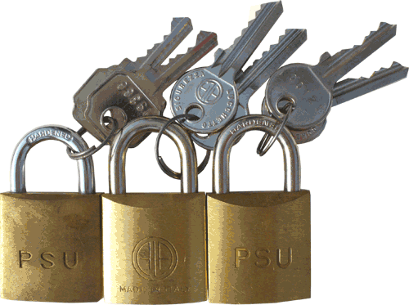
The Three Kinds of Lock-Opening

Slide 4
The Three Kinds of Lock-Opening
Lockpicking – what we do TOOOL provides the knowledge and the means – what spies do TOOOL provides neither knowledge nor means

Slide 5
The Three Kinds of Lock-Opening
Lockpicking TOOOL provides the knowledge and the means
Quick & Dirty TOOOL provides neither knowledge nor means
Notes:
Engage with the lock. Love the lock.
Bump keys

Slide 6
The Three Kinds of Lock-Opening
LockpickingTOOOL provides the knowledge and the means
Quick & Dirty TOOOL provides knowledge. . . but no means
Covert & High-Tech TOOOL provides neither knowledge nor means

Slide 7
The Three Kinds of Lock-Opening
Lockpicking – what we do TOOOL provides the knowledge and the means
Quick & Dirty – what criminals do TOOOL provides knowledge. . . but no means
Covert & High-Tech – what spies do TOOOL provides neither knowledge nor means

Slide 8
The Three Kinds of Lock-Opening
Lockpicking – what we do TOOOL provides the knowledge and the means
Quick & Dirty – what criminals do TOOOL provides knowledge. . . but no means
Covert & High-Tech – what spies do TOOOL provides neither knowledge nor means

Slide 9
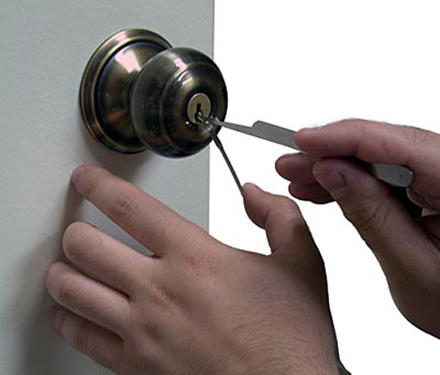
Lockpicking is Simple!
Notes:
Two tools. Not one. Not three. Not a screwdriver and a pen knife. Two tools. More on this later.

Slide 10
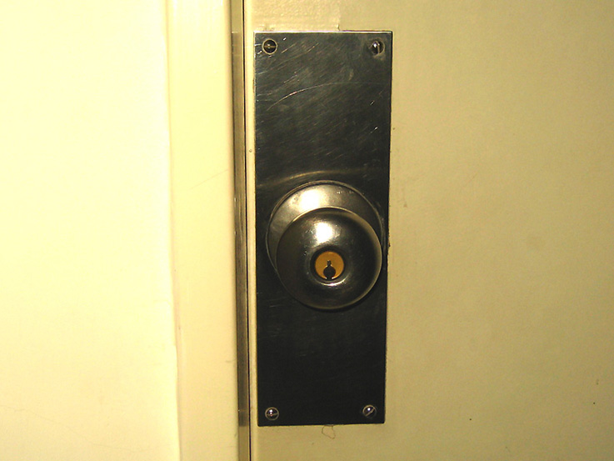
Pin Tumbler Locks

Slide 11
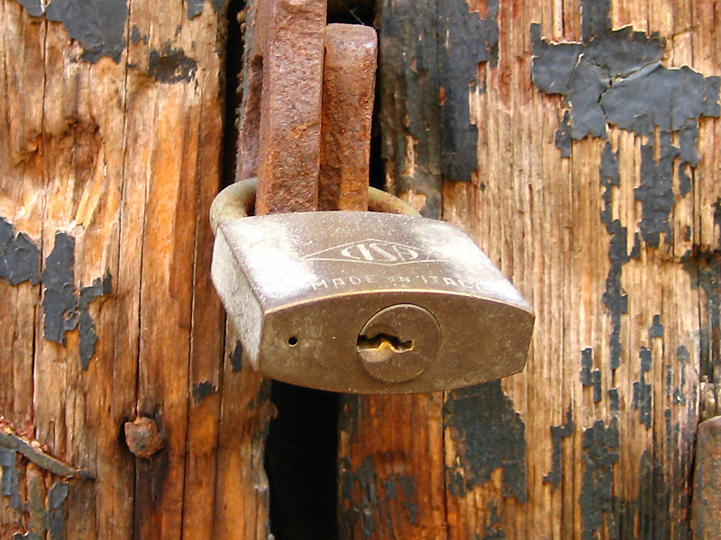
Pin Tumbler Locks

Slide 12
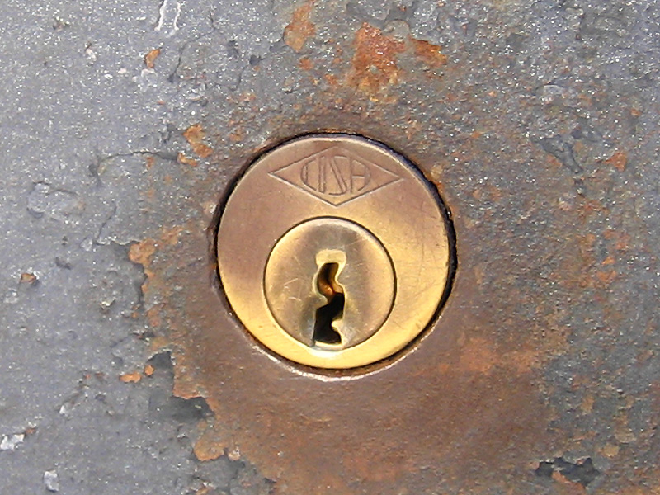
Pin Tumbler Locks

Slide 13
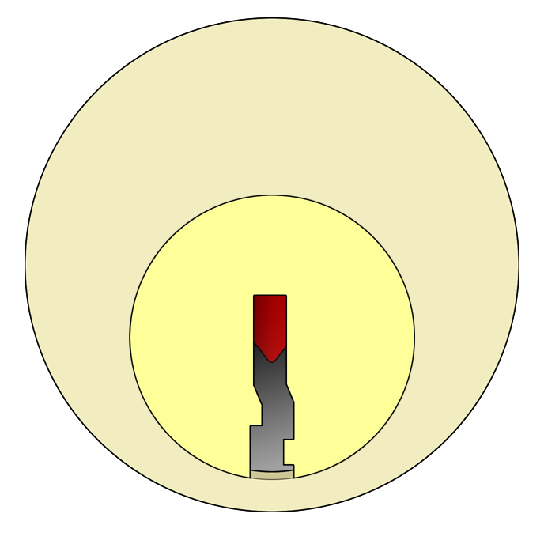
Outer View

Slide 14
Outer View
Body
Key pin
Plug
Keyway

Slide 15
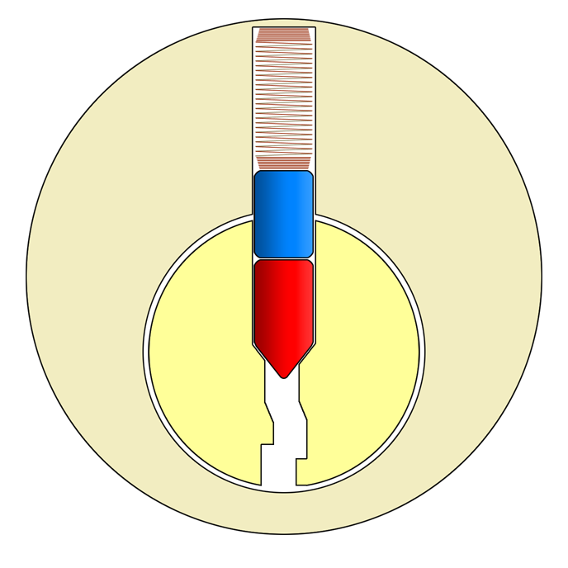
Inner View

Slide 16
Anatomy of a Lock
Spring
Driver pin
Key pin
Plug

Slide 17
Anatomy of a Lock
Spring
Shear line
Driver pin
Key pin
Plug
Notes:
We call the key pin and the driver pin together a “pin stack” because it’s, well, a stack. Of pins.

Slide 18
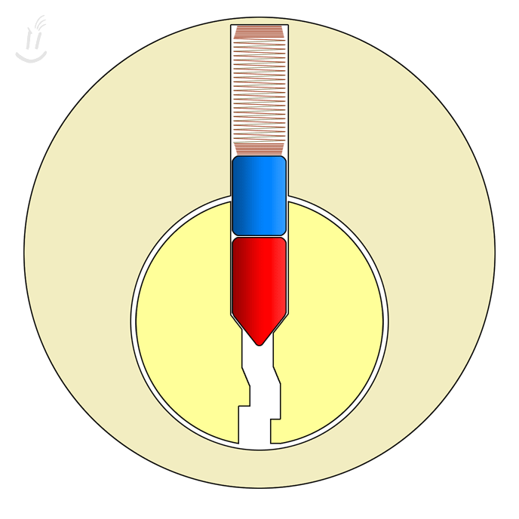
Attempt Without a Key
Notes:
Plug moves a bit, but not much. How far? Only until it gets stopped by the driver pin. That’s the driver pin’s job: Stop the plug from turning unless the driver pin has been pushed to the right height. What usually pushes the pin stack up so the driver pin is at the right height? Yeah, the key.

Slide 19
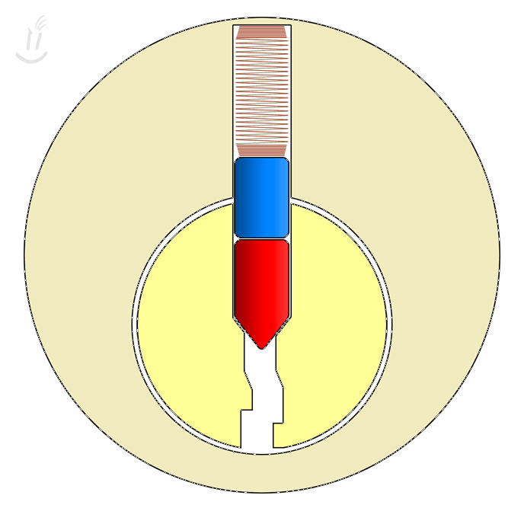
Operating With a Key

Slide 20
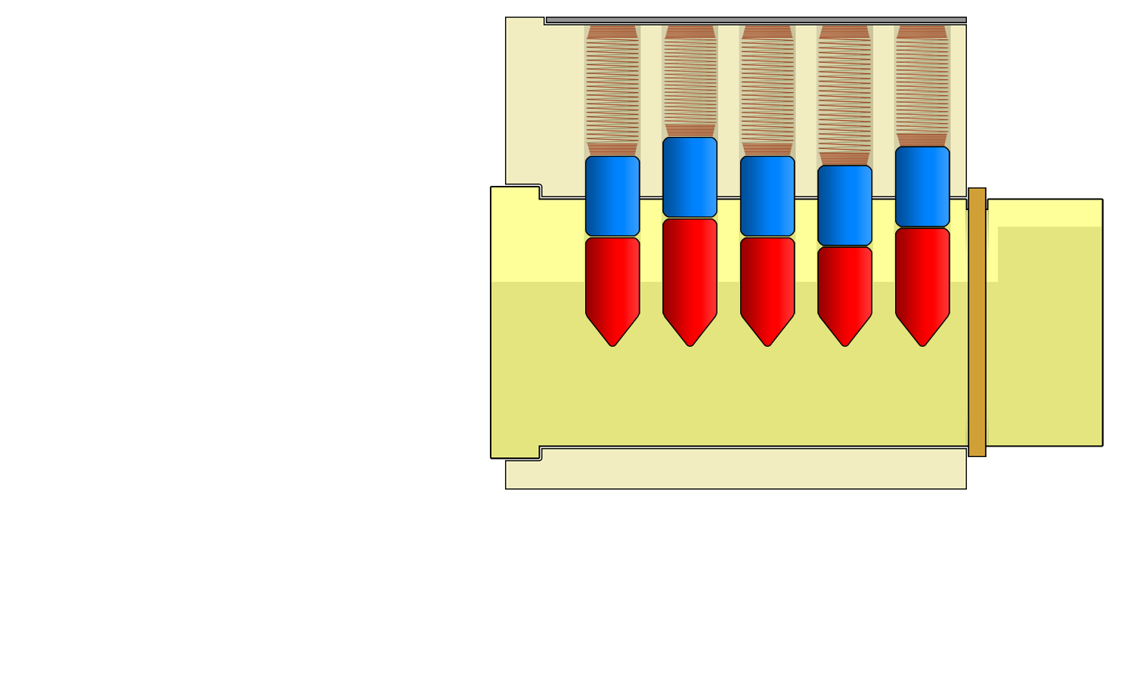
Pin Stacks
Notes:
This is a lock at rest, without a key in it, and with the driver pins stuck halfway between the plug and the housing, blocking the plug from turning.
As you can see, all of the driver pins are the same size (height), but all of the key pins are different heights.
This is what makes each lock take a different key, because only a key cut to make up for the varying heights of the key pins can even out the differences and create a clear uninterrupted shear line.
(Note: The pins don’t fall all the way down to the bottom of the lock because the drilled hole that each pin is in tapers to the bottom so that the key can get in but the pin can’t get out. Go back and look at the previous slide to see how this works.)

Slide 21
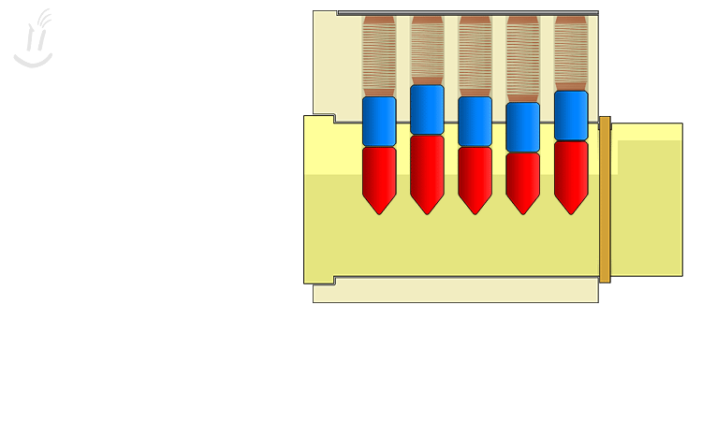
Key Operation

Slide 22
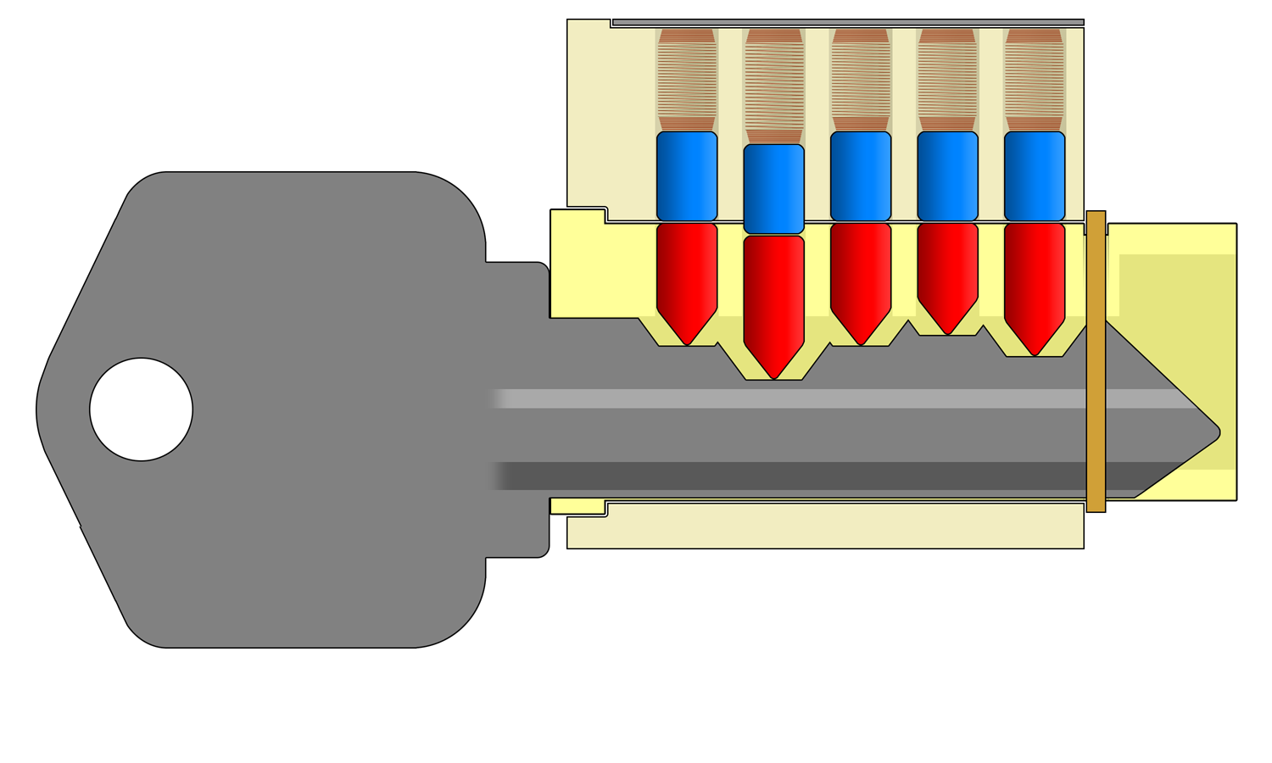
One Bitting Too Low
Notes:
Unlike horseshoes and hand grenades, close doesn’t count here. Only when every pin stack is moved to the right height

Slide 23
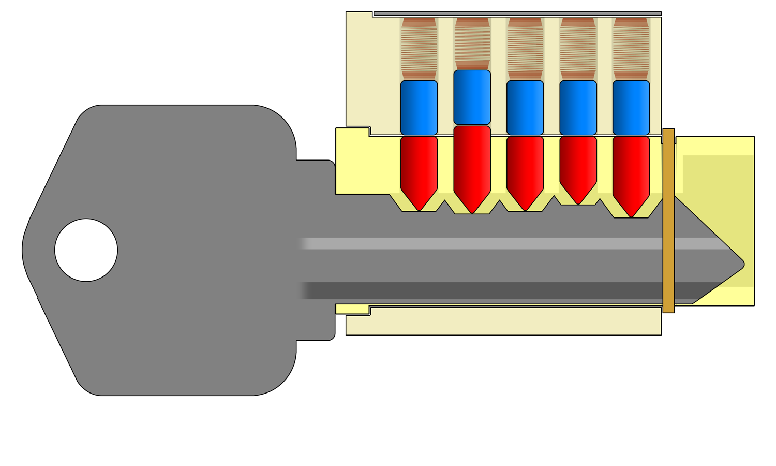
One Bitting Too High
Notes:
Replaced one problem with another.

Slide 24
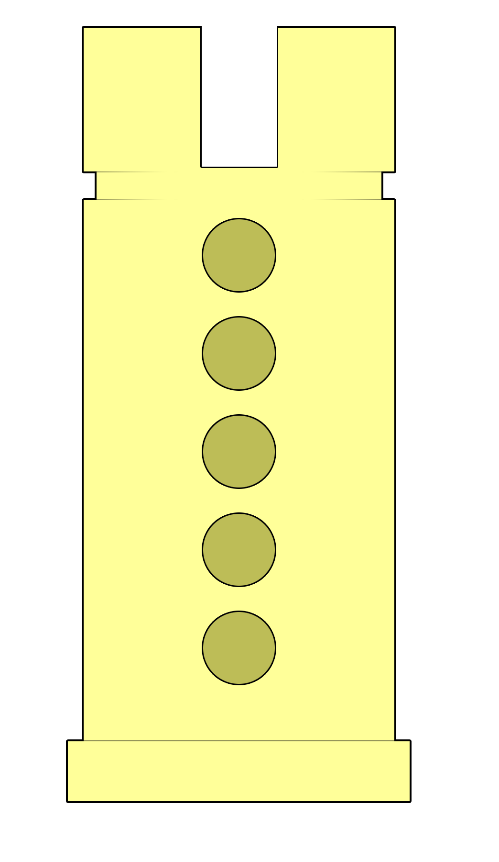
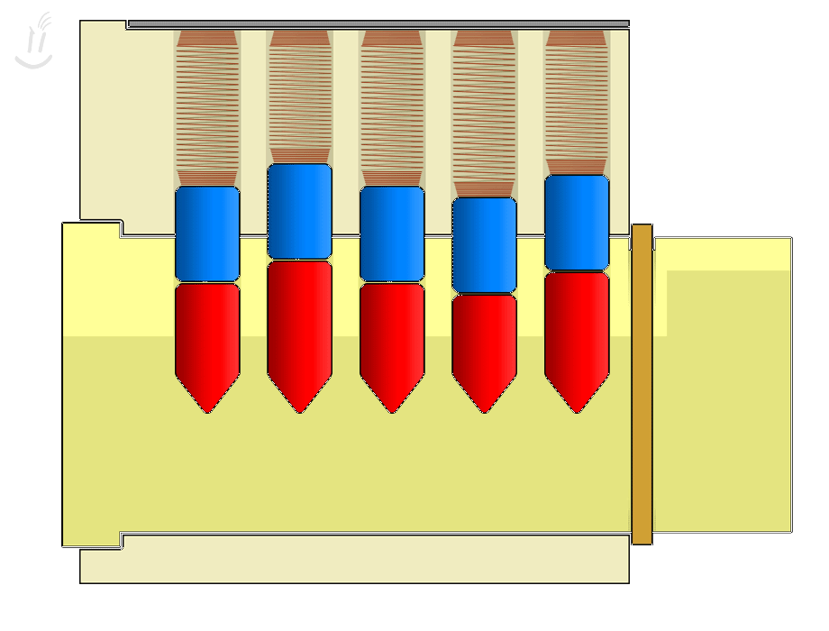
In a Perfect World
Notes:
If the lock were perfectly manufactured, lockpicking would not be possible.

Slide 25
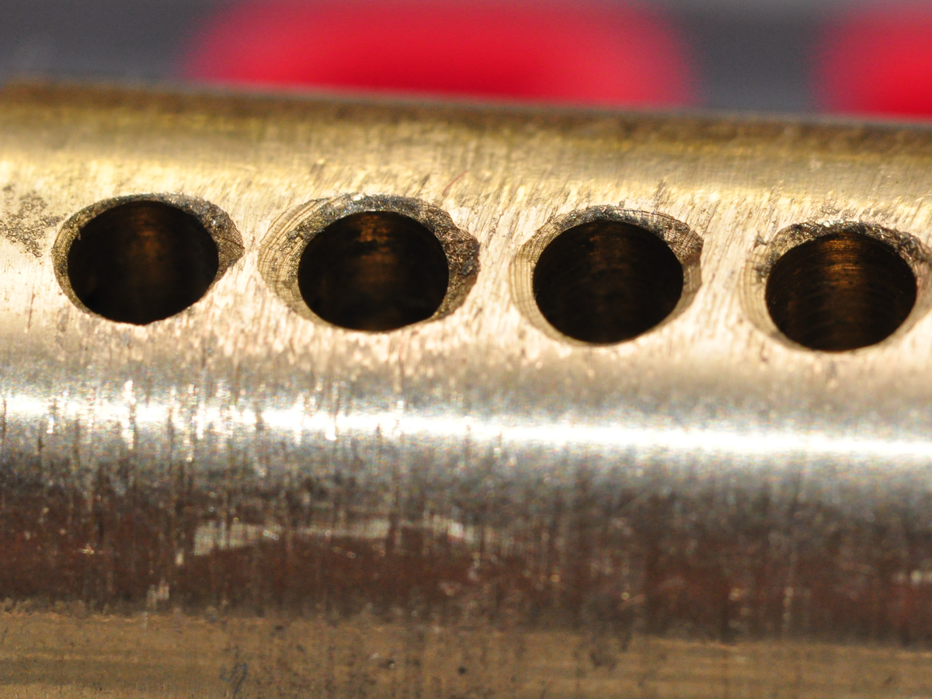
In the Real World
Notes:
In the real world, locks cost money and so they have to be made cost effectively. Often, this means “cheaply”. Equipment gets old, it gets misaligned, it gets dull, it rattles. The lower cost the lock, the lower the specification, the more room for mechanical defects.

Slide 26
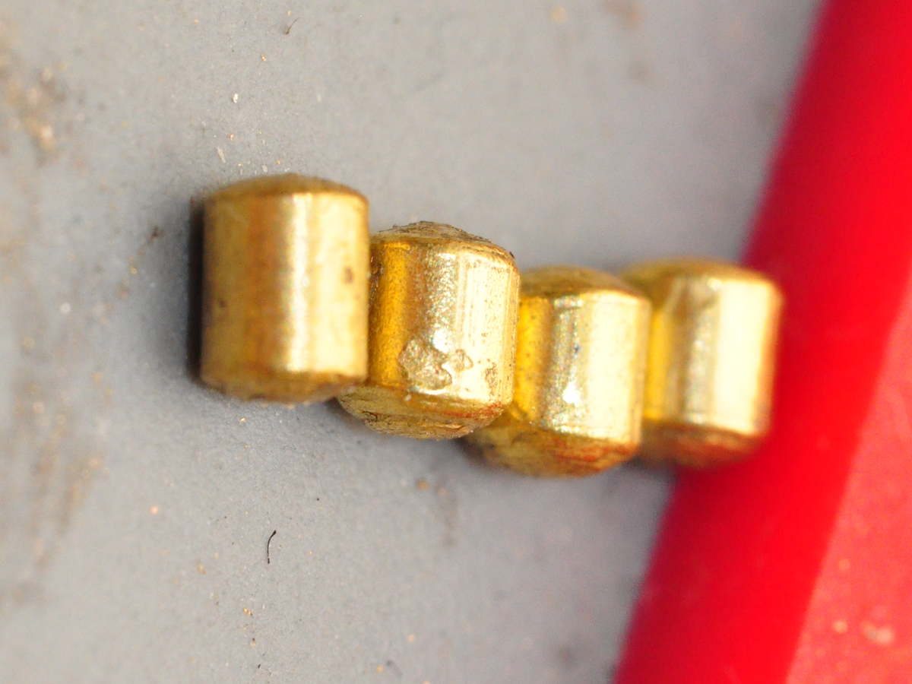
In the Real World
Notes:
Miscast, pitted, rough, rusted, all of the parts of a lock can have small defects that make them work not quite right.

Slide 27
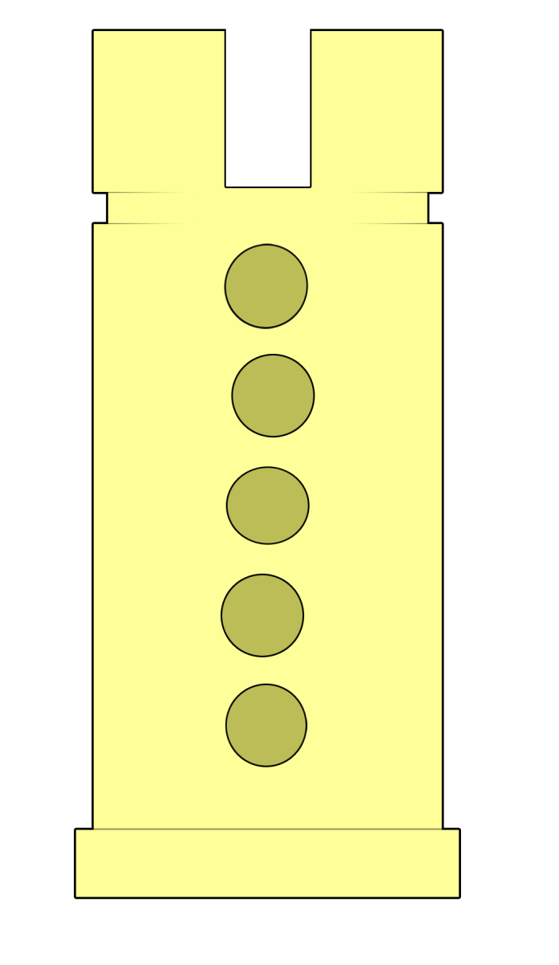
In the Real World
Notes:
The most important defect for us as lockpickers is the misalignment of the pin holes.
As the holes are drilled, they are fractions of a millimeter off center in a random deviation.
This is an exaggeration, but the it shows the principle. The dotted line provides a reference to highlight the misalignment of the pin holes.
All of the pin holes are going to be slightly off center one direction or another, but one of them will be MOST off center. This is where we start.
Here’s why:

Slide 28
Attempt Without a Key
Notes:
Let’s just consider the one pin that is most off center. (In the diagram on the last slight, it’s the 4th pin. [You can have the audience answer this to make sure they’re tracking])
As we’ve seen, if you try to turn a lock plug without a key, it doesn’t open, but something happens.
The plug has a little bit of play before it stops.
What is it stopping against? The first thing it runs into is the most out of line pin.
So it stands to reason that if we move that pin out of the way, it will be able to continue turning.

Slide 29
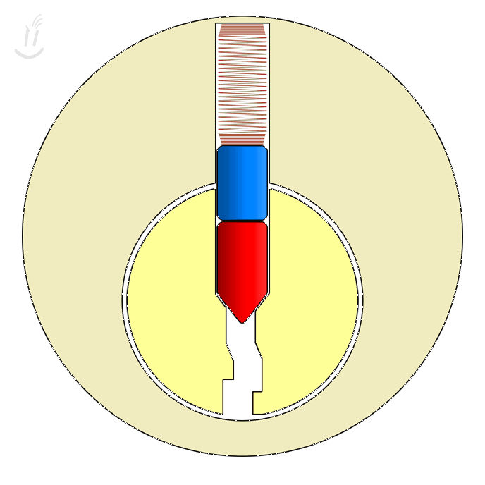
“Setting” a Binding Pin
Notes:
To move the driver pin out of the way, we use a pick to push up on the key pin (red pin).
Once the driver pin is high enough that it’s out of the way, the plug turns ever so slightly.
Now the hole that the driver pin went up through is no longer there.
The driver pin is trapped; it can’t go back the way it came.
This is setting a pin, and once you’ve set a pin you can basically forget about it as long as you keep a little bit of turning tension on the plug.

Slide 30
The Key Pin Can Still Move Freely
Notes:
The key pin is isolated from the spring.

Slide 31
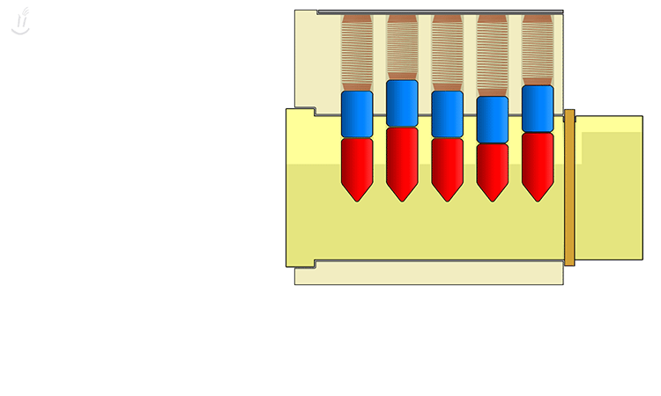
Setting Multiple Pins

Slide 32
Take Caution to Avoid Over-Lifting
Notes:
Don’t replace one problem with another.

Slide 33
The Turning Tool

Slide 34
Lockpicking is Simple! (redux)
Notes:
We talked about what the pick does, now we talk about what the tension tool does.

Slide 35
Turning Tool
Notes:
Different sizes fit in different keyways; if the tool you’re using doesn’t sit well, try another one.

Slide 36
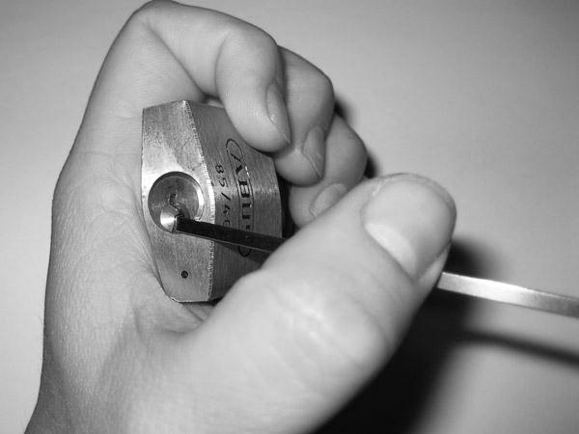
Bad Turning Tool Usage (Pulling)

Slide 37
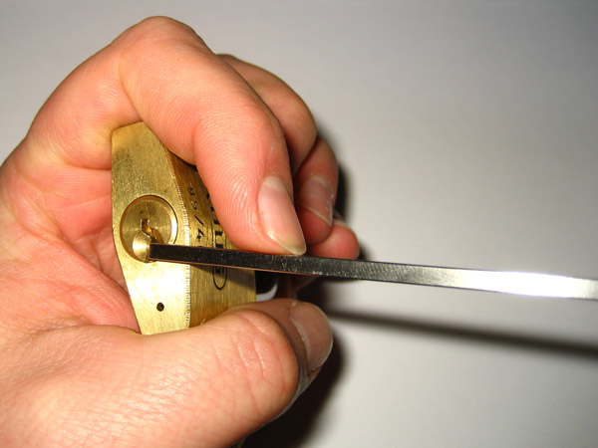
Better Turning Tool Usage (Pushing)

Slide 38
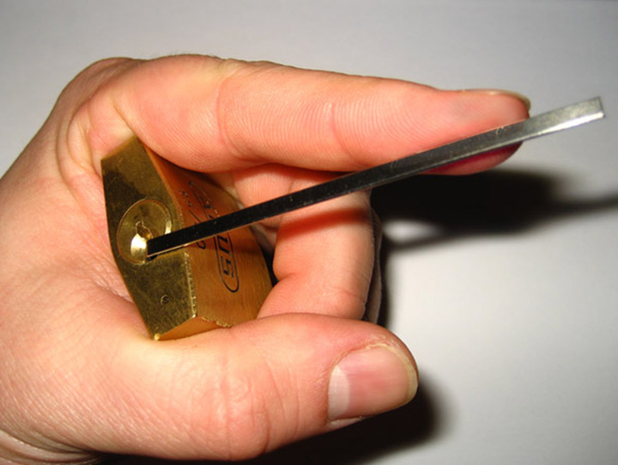
Best Turning Tool Usage (Pushing Out at Tip)

Slide 39
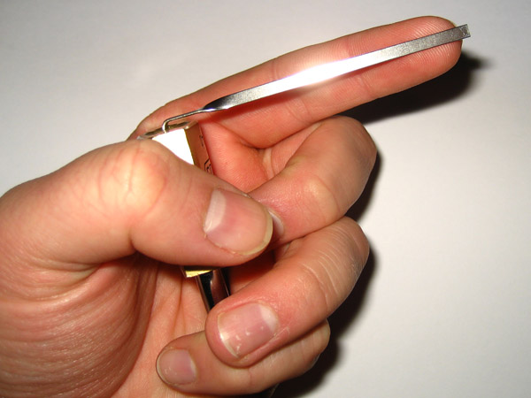
Good Turning Tool Pressure

Slide 40
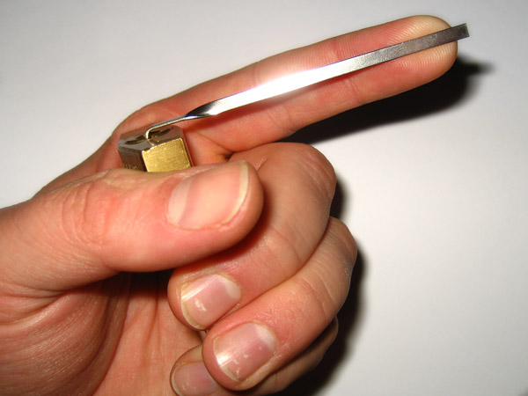
Too Much Turning Tool Pressure!

Slide 41
Which Pick do I use?

Slide 42
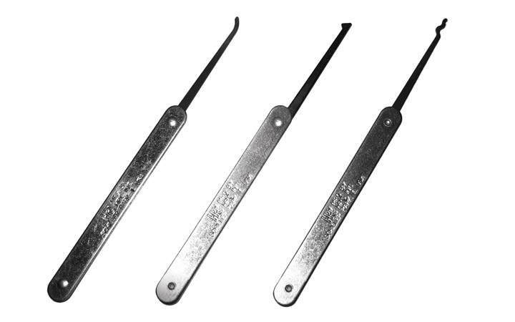
Different Shapes for Different Purposes
Notes:
DON’T BEND MY TOOLS!

Slide 43
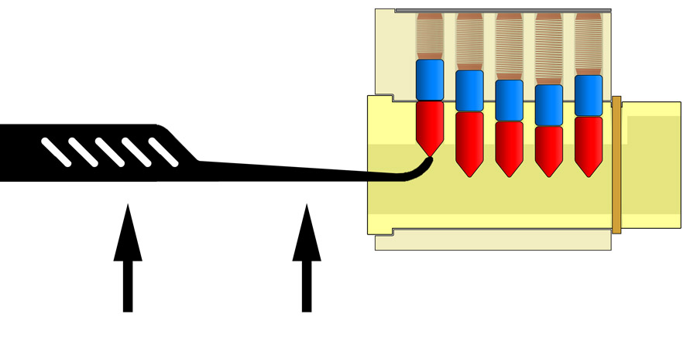
Hook: Direct Lifting

Slide 44
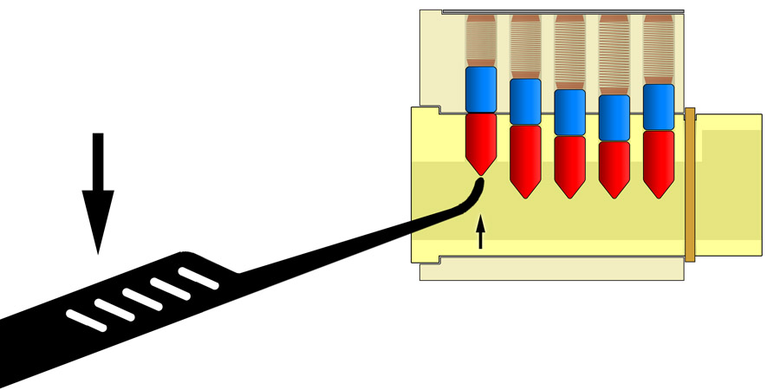
Hook: Rocking Lifting

Slide 45
Be gentle!
Notes:
If you like to do the rocking lifting style, be careful not to use the pick as a crowbar.
If it’s not lifting with gentle pressure, something isn’t right (probably too much turning pressure or already overset) and cranking harder won’t help.
Don’t make the bunny cry.

Slide 46
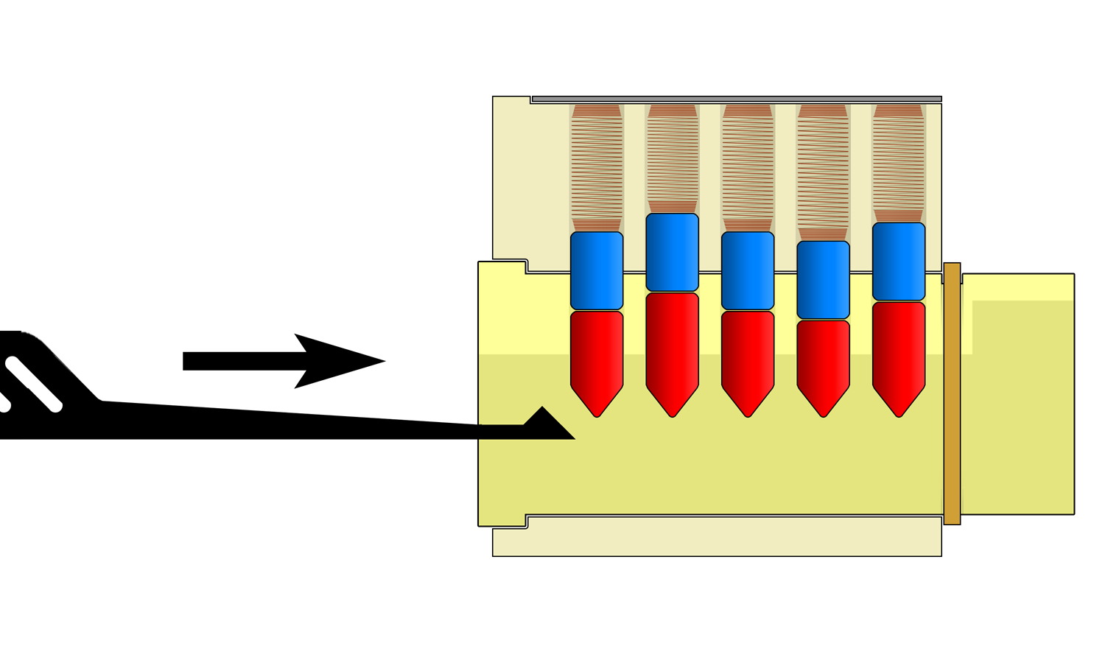
Half-Diamond: Raking/Shoveling
Notes:
The hook/finger is great for hitting individual pins very specifically, but it pretty much forces you to release and reengage with each new pin.
The half diamond pick is a nice compromise because you can both individually pick but also move fairly smoothly from one to the other.
The advantage is you move more easily, the disadvantage is it may make it just a little bit more difficult to keep track of which pin you’re on.

Slide 47
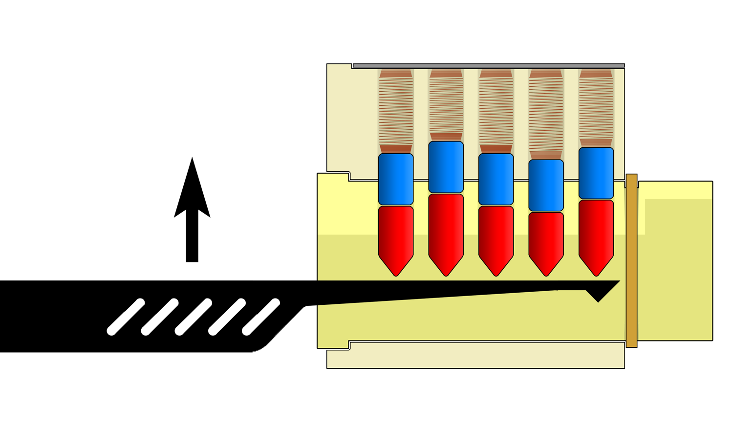
Half-Diamond: Counting Pins
Notes:
Whenever you encounter a new lock, a great first step is to count the pins.
This will give you an idea of how difficult the lock is, as well as where the pins are and what they sound like.
You’ll need a tool with a flat back on it, which usually means a half diamond.
Shove it all the way to the back of the lock.

Slide 48
Half-Diamond: Counting Pins
Notes:
Then live the whole thing upward together like a tray, lifting all the pins and compressing all the springs.

Slide 49
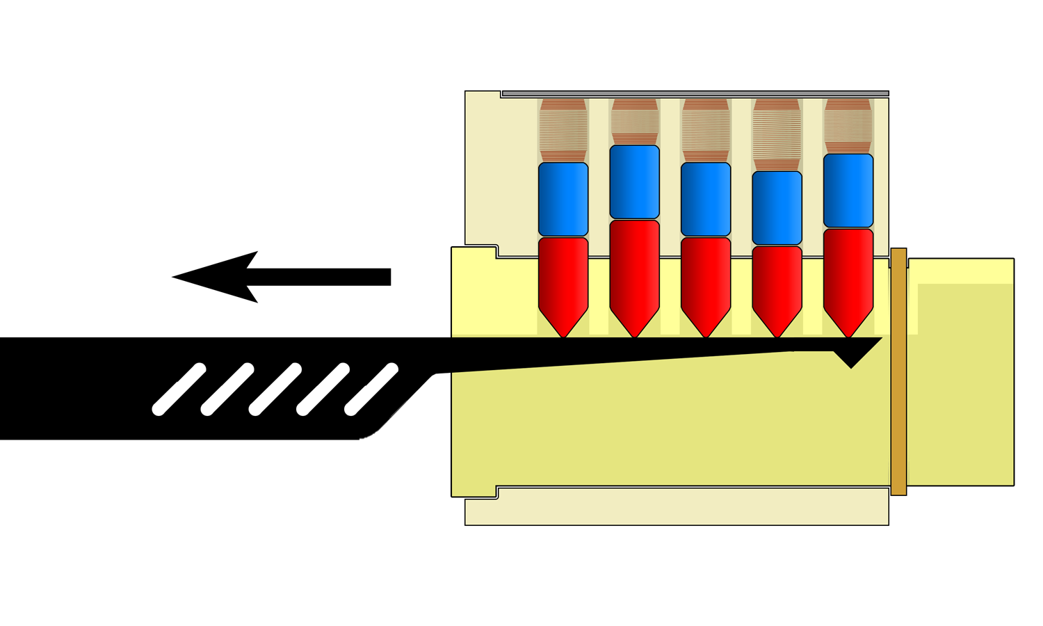
Half-Diamond: Counting Pins
Notes:
Once all of the pins are lifted and all of the springs are loaded, be ready to listen and feel.
Maybe hold it up to your ear.

Slide 50
Counting Pin Stacks
Notes:
Carefully draw the pick out of the lock.

Slide 51
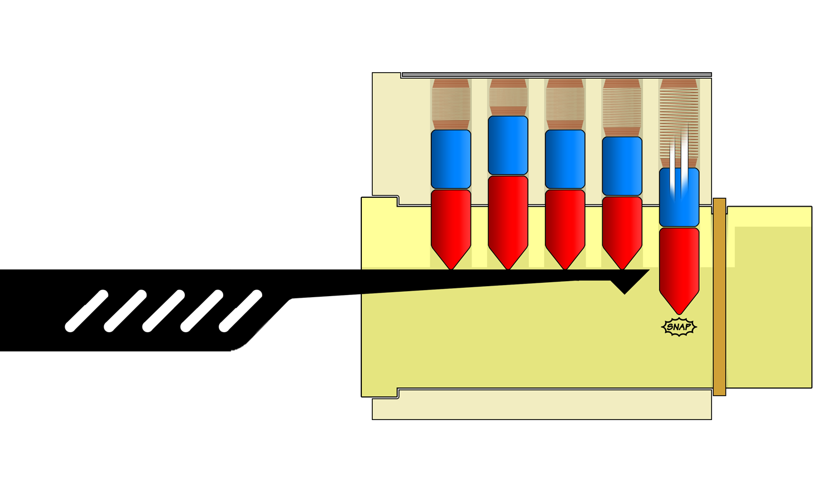
Counting Pin Stacks
Notes:
As you slide off each pin, the spring will expand, shooting the pins down to the bottom of the lock with a snap that you can hear and feel.

Slide 52
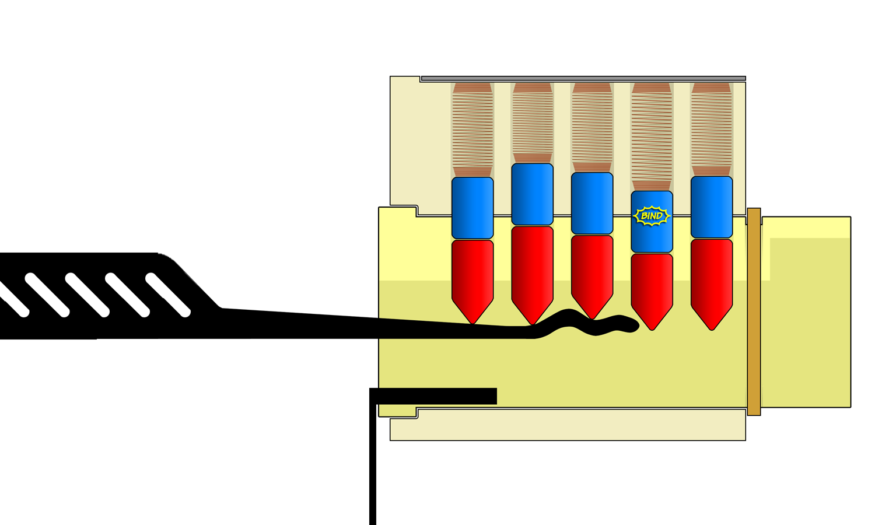
Raking

Slide 53
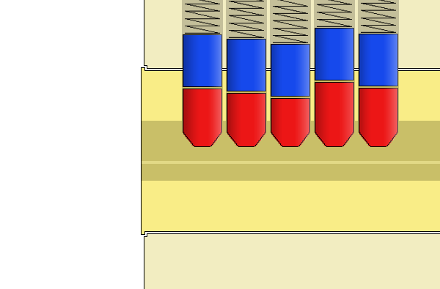
Raking

Slide 54
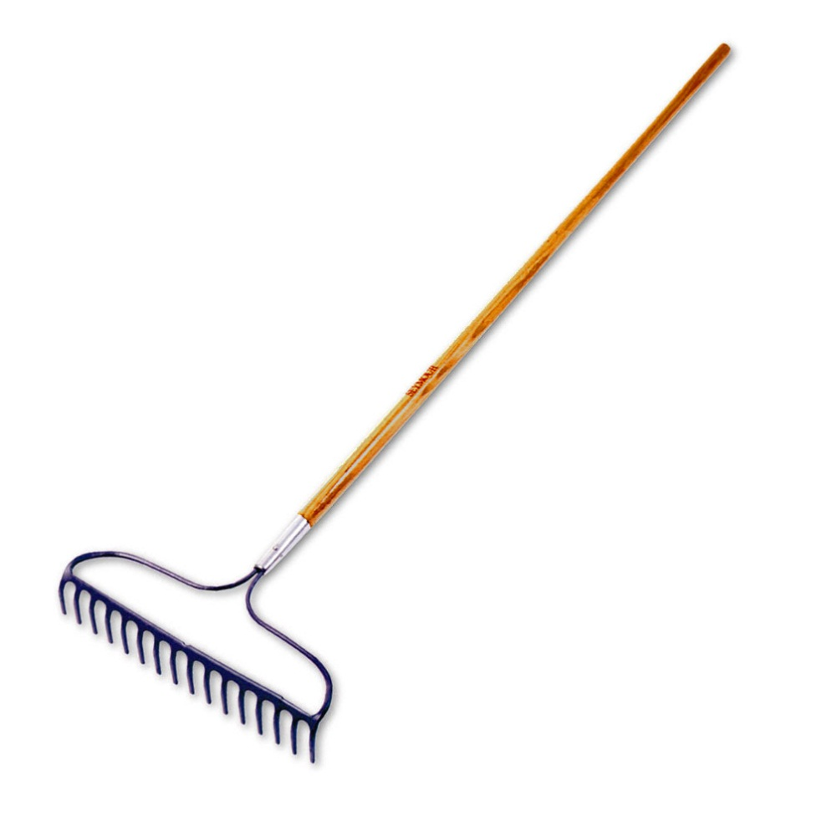
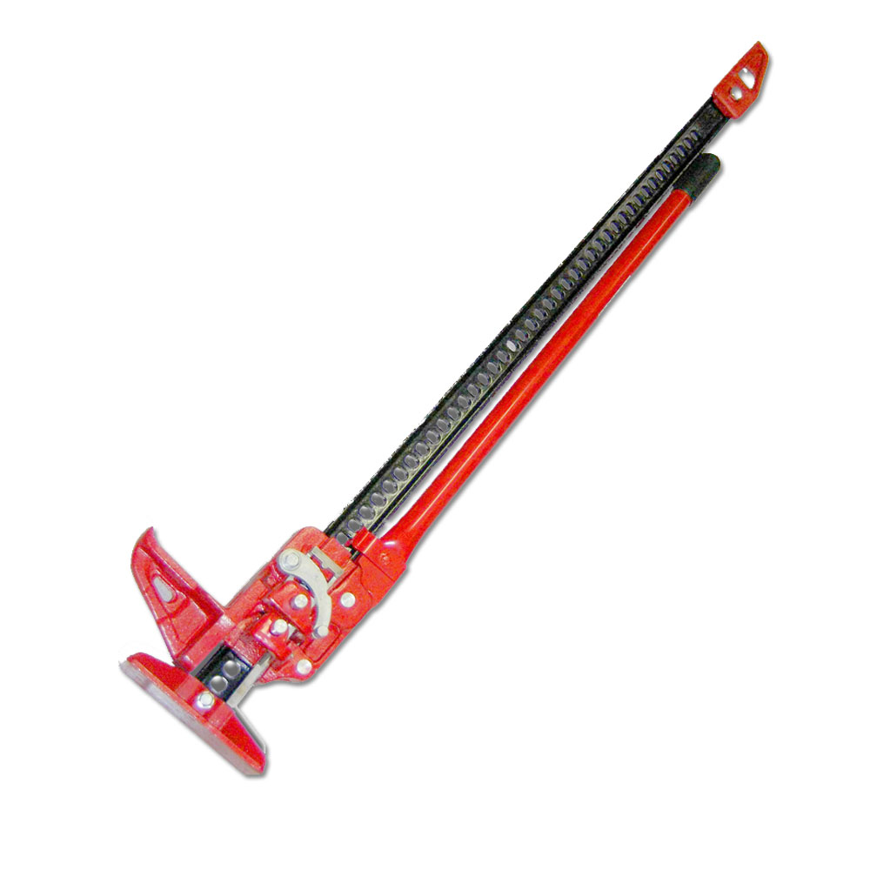
“Raking” vs. “Lifting”

Slide 55
Raking

Slide 56
Raking

Slide 57
Lifting

Slide 58
What is Jiggling ?
In Between Raking & Lifting …

Slide 59
What is Jiggling ?
… There is “Jiggling”

Slide 60
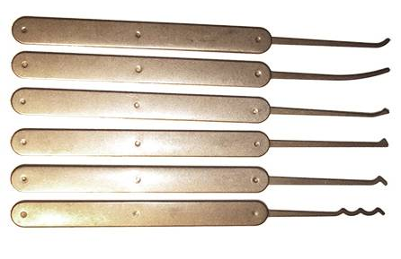
What is in your kit? Picks
Hook
Reach
Offset Half-Diamond
Half-Diamond
Half-Diamond (hollow)
Rake

Slide 61
What is in your kit? Turning Tools
Different widths
Different thicknesses
Different lengths

Slide 62
What is in your kit? Turning Tools
Different widths
Different thicknesses
Different lengths
Why?

Slide 63
What is in your kit? Turning Tools
Different widths
Different thicknesses
Different lengths
Why?
Different tools fit
different keyways
In different ways.

Slide 64
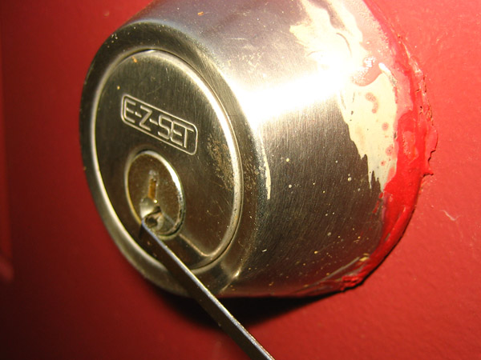
Turning Tool Position: “Edge of the Plug”

Slide 65
“Standard” Turning Tools

Slide 66
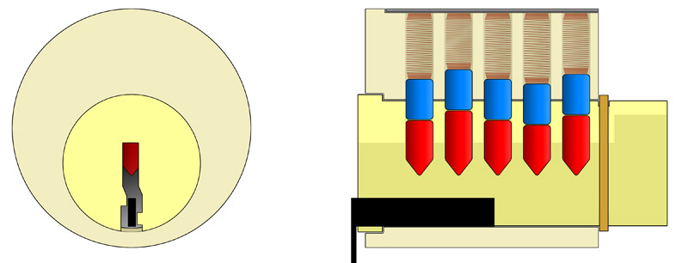
Space in the Keyway

Slide 67
Space in the Keyway

Slide 68
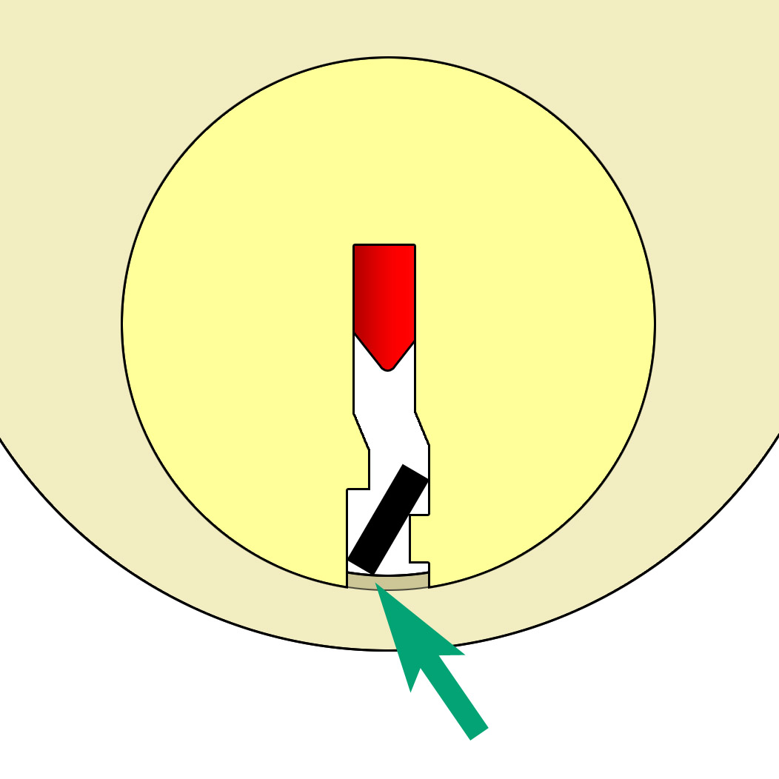
Careful to not Cause Extra Friction

Slide 69
“Standard” vs “Flat” Turning Tools

Slide 70
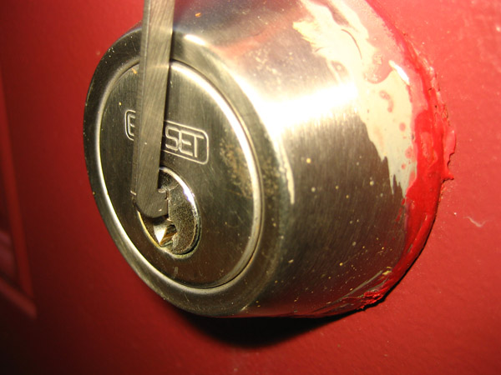
Turning Tool Position: “Center of the Plug”

Slide 71
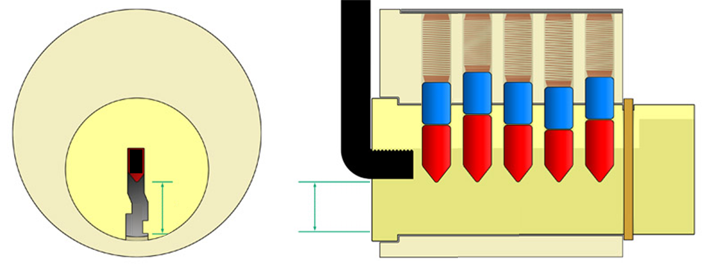
More Space in the Keyway

Slide 72
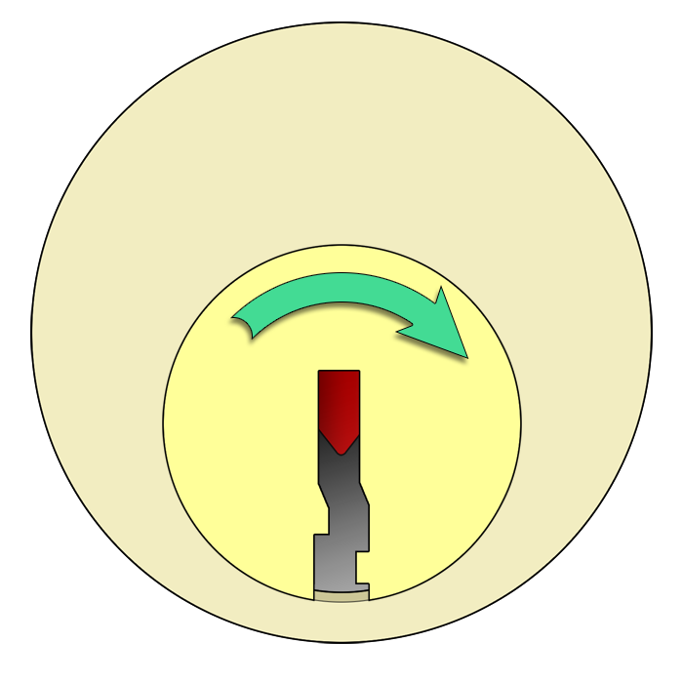
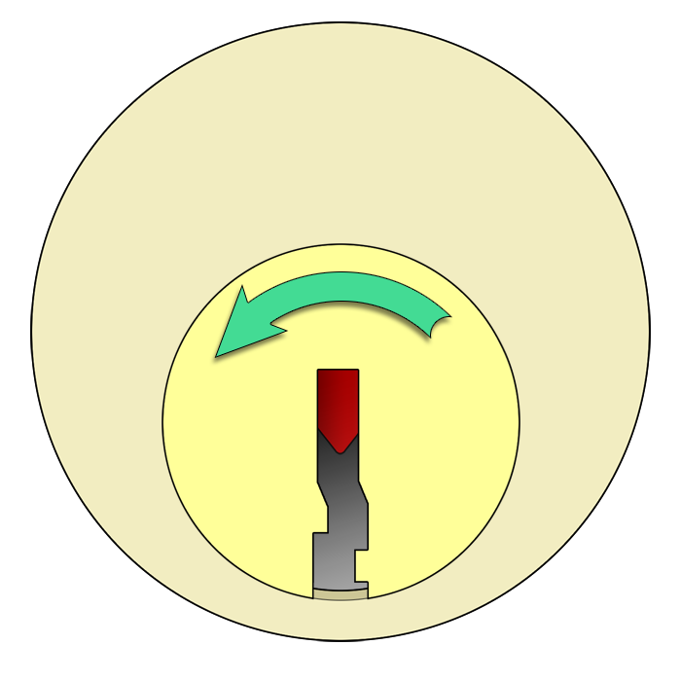
Turning Direction

Slide 73
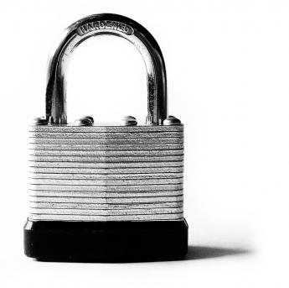
Turning Direction

Slide 74
Who Wants To Try?

Slide 75
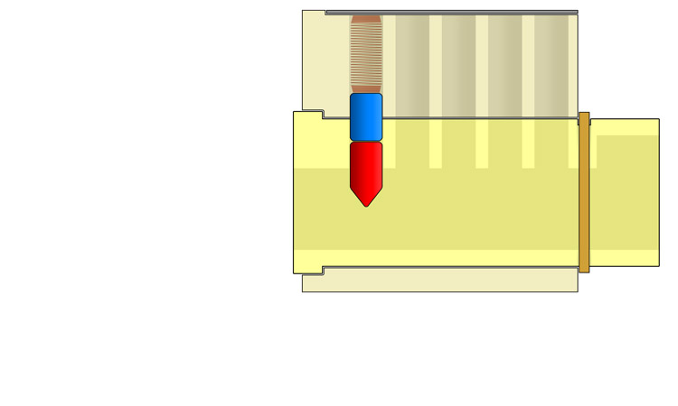
Starter Exercises – Lift without tension

Slide 76
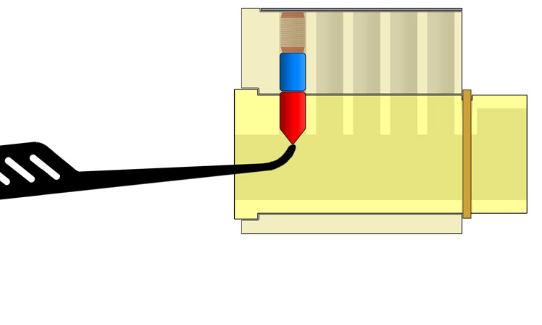
Starter Exercises – Lift without tension

Slide 77
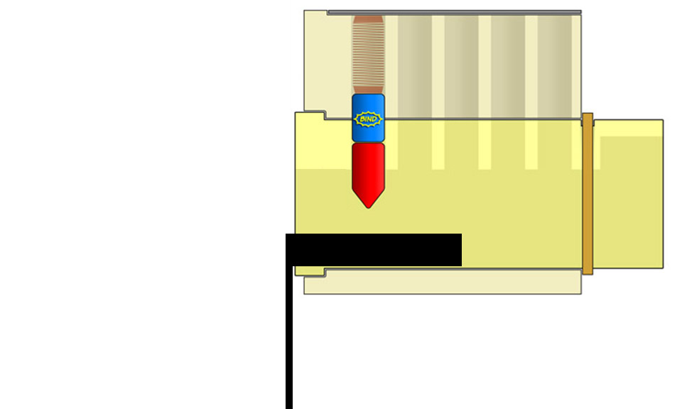
Starter Exercises – Lift with tension

Slide 78
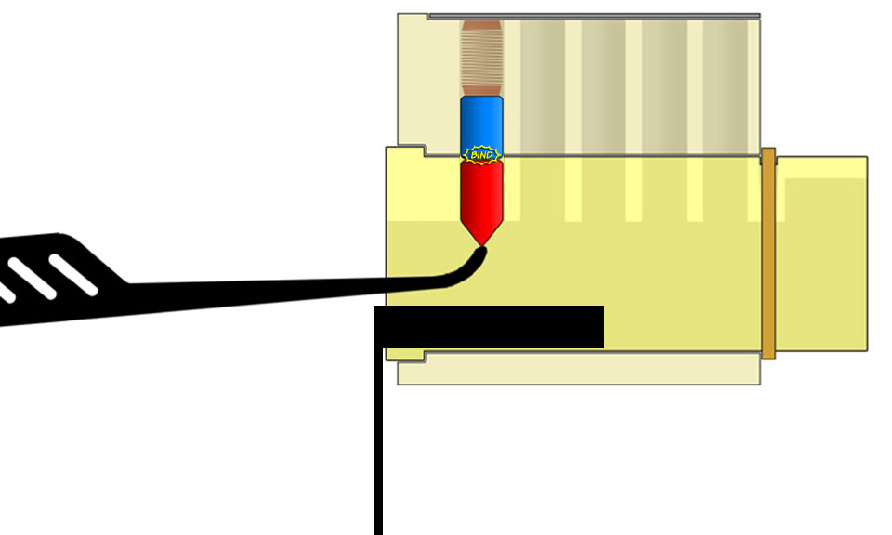
Starter Exercises – Lift with tension

Slide 79
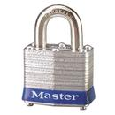
Practice Locks

Slide 80
FAQs
✔
✗

Slide 81
The Two Most Important Things…
RELAX

Slide 82
The Two Most Important Things…
OPEN!

Slide 83
Want more?
Washington, D.C.
Philadelphia, PA
New York, NY
Rochester, NY

Slide 84
Questions?

Slide 85
Pick-Resistant Locks

Slide 86
Pick-Resistant Keyways
Simple… … straight and wide

Slide 87
Pick-Resistant Keyways
Simple… … straight and wide
Medium… … straight but narrow

Slide 88
Pick-Resistant Keyways
Simple… … straight and wide
Medium… … straight but narrow
Complex… … thinner and curvy

Slide 89
Pick-Resistant Keyways
Simple… … straight and wide
Medium… … straight but narrow
Complex… … thinner and curvy
Hard… … lots of angles

Slide 90
Pick-Resistant Keyways
Simple… … straight and wide
Medium… … straight but narrow
Complex… … thinner and curvy
Hard… … lots of angles
Fiendish… … overlapping wards

Slide 91
Pick-Resistant Pins

Slide 92
Pick-Resistant Pins – Spool Pin

Slide 93
Pick-Resistant Pins – Spool Pin Binding

Slide 94
Pick-Resistant Pins – Spool Pin Picking

Slide 95
Pick-Resistant Pins – Mushroom Pin

Slide 96
Pick-Resistant Pins – Serrated Pin

Slide 97
Pick-Resistant Pins – ASSA “Sneaky” Pin

Slide 98
Pick-Resistant Pins – TrioVing “Double Mushroom” Pin

Slide 99
Pick-Resistant Locks
a substantial improvement…
…can be picked, but only with much skill and time

Slide 100
Questions?

Slide 101
Resources for Learning More

Slide 102
Resources For Learning More
Books
Practical Lock Picking & other books by Deviant Ollam
High Security Mechanical Locks by Graham Pulford
Locks, Safes, & Security by Marc Tobias
Videos
YouTube & Google
http://connect.waag.org/toool
http://deviating.net/lockpicking/videos.html
On The Web
http://toool.us ‒ http://toool.nl
http://blackbag.nl ‒ http://deviating.net

Slide 103
Resources For Learning More

Slide 104
Legal Questions
We are not lawyers
Purchase/Shipping through mail
Lock manufacturer
Auto dealer
Law enforcement
Repo man
Bona fide locksmith
Possession & use
Burglary tools statutes
During an illegal act

Slide 105
Legal Questions
http://toool.us/laws.html
Legal by statute
Legal, no criminal statute
Legal, but note other laws
Prima Facie clause
Picks are more restricted

Slide 106
Acquiring Locks
Free
Basements, garages, yard sales
Ask neighbors, ask locksmiths
For sale
Vary your sources
Hardware store vs. eBay
Specialized
Progressive kits
Ultimate practice lock

Slide 107
Want more?
Washington, D.C.
Philadelphia, PA
New York, NY
Rochester, NY

